Slide 1
Lecture 3 Perceptron
Lê Anh Cường

Slide 2
Outline
Biological Neuron
Artificial Neural Network
Perceptron
Learning Perceptron
Application of Perceptron

Slide 3
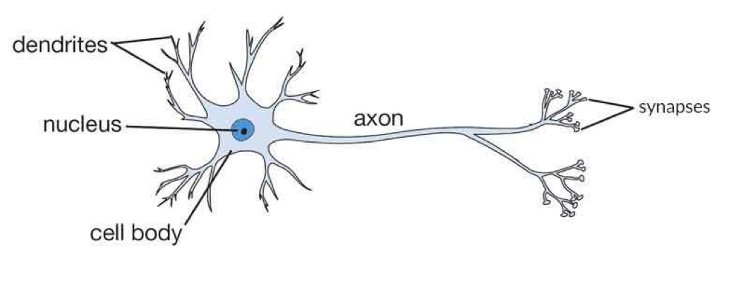
Biological Neuron
Function of Dendrite (đuôi gai)
It receives signals from other neurons.
Soma (cell body)
It sums all the incoming signals to generate input.
Axon Structure (cấu trúc trục)
When the sum reaches a threshold value, neuron fires and the signal travels down the axon to the other neurons.
Synapses Working (khớp thần kinh)
The point of interconnection of one neuron with other neurons. The amount of signal transmitted depend upon the strength (synaptic weights) of the connections.
The connections can be inhibitory (decreasing strength) or excitatory (increasing strength) in nature.

Slide 4
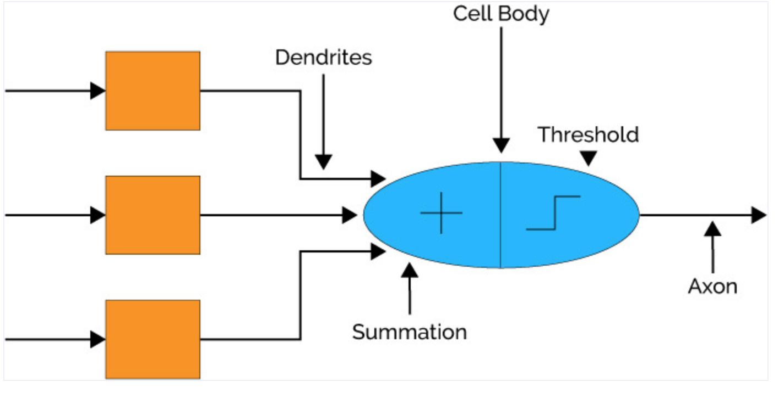
Biological Neuron

Slide 5
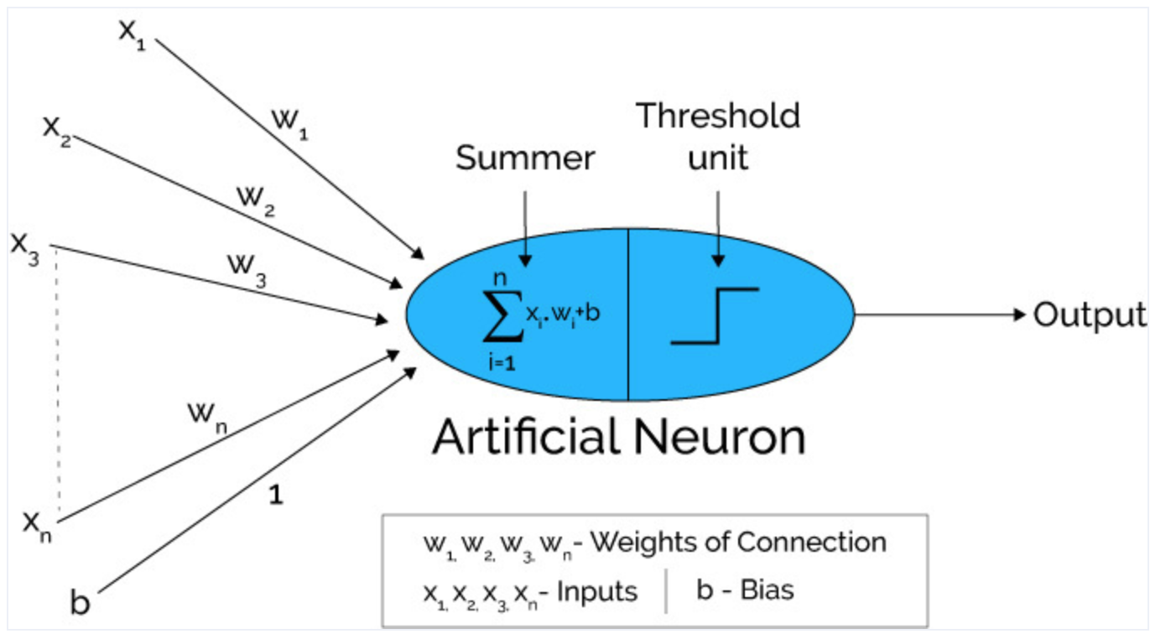
Artificial Neural Network: Single Perceptron

Slide 7
Artificial Neural Network: Multi-Perceptron

Slide 8
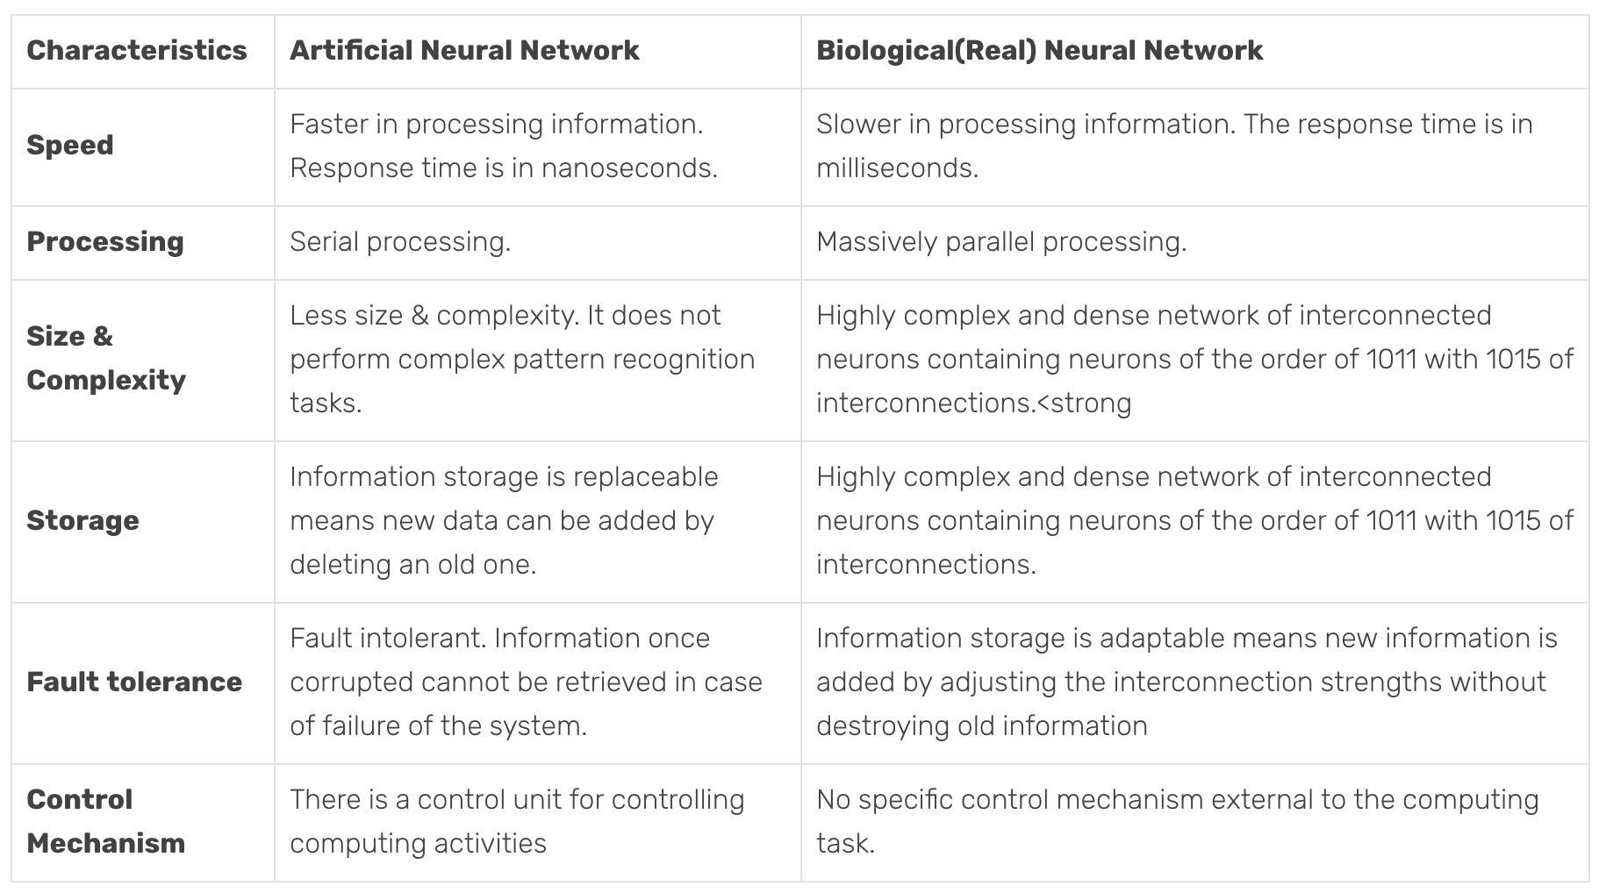
Difference Between Artificial Neural Networks (ANN) and Biological Neural Networks (BNN)

Slide 9
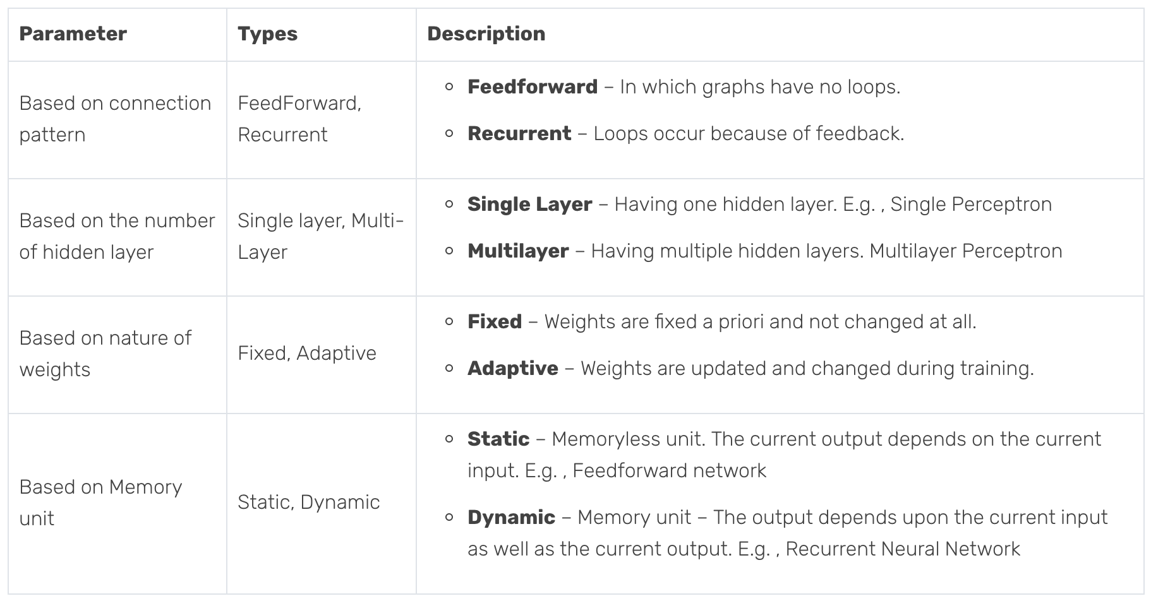
Types of Artificial Neural Networks

Slide 10
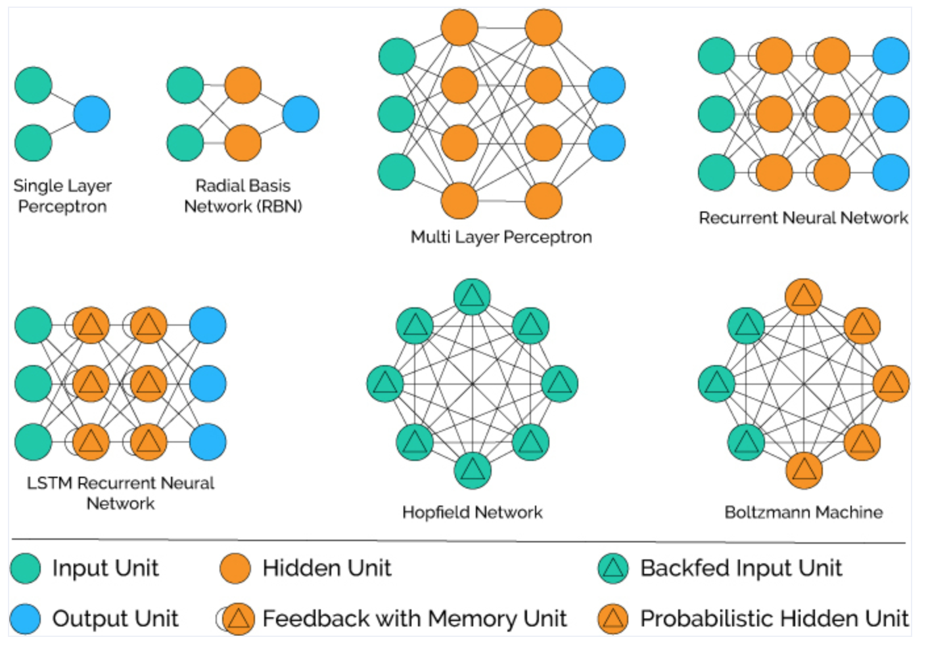
Types of Artificial Neural Networks

Slide 11
Perceptron
Neural Network is having two input units and one output units with no hidden layers. These are also known as single layer perceptron.

Slide 12
Perceptron

Slide 13
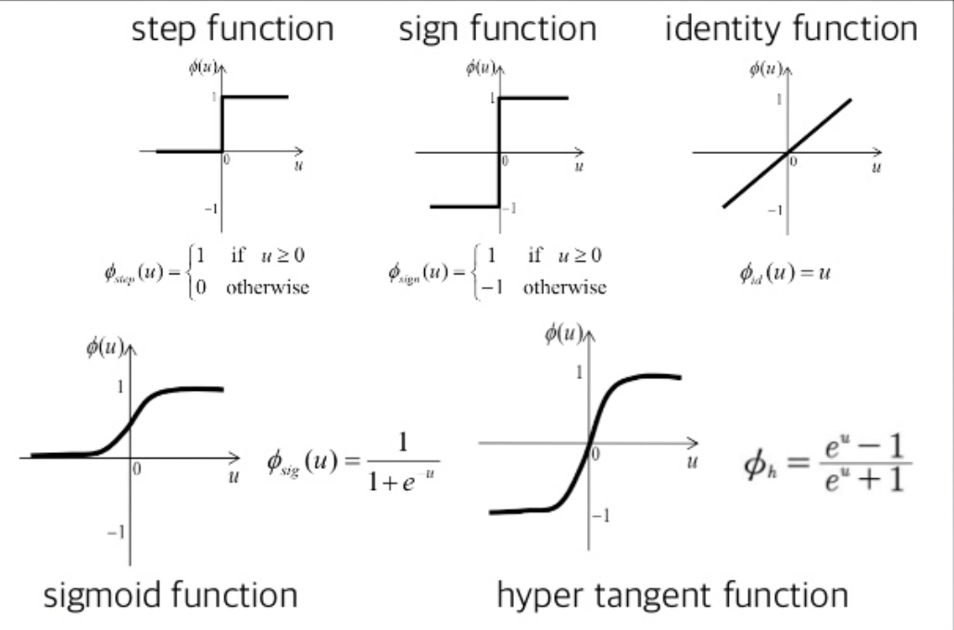
Activation functions

Slide 14
Activation functions

Slide 15
Learning Perceptron
https://machinelearningcoban.com/2017/01/21/perceptron/

Slide 16
Learning perceptron
With different activation functions

Slide 17
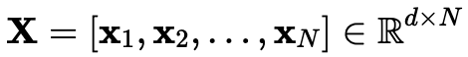
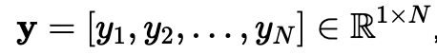
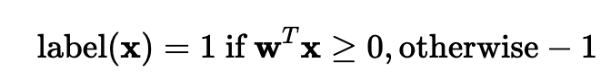
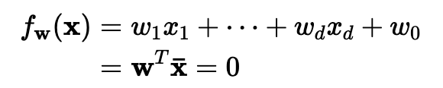
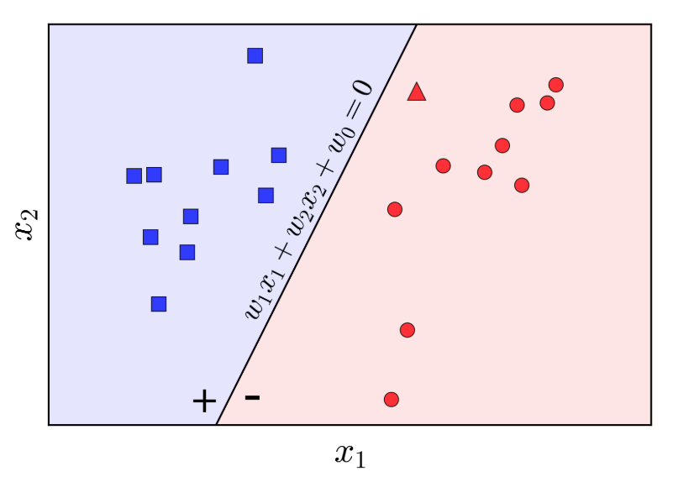
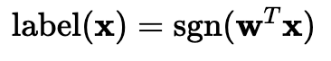
Learning Perceptron

Slide 18
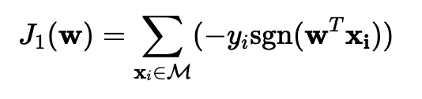
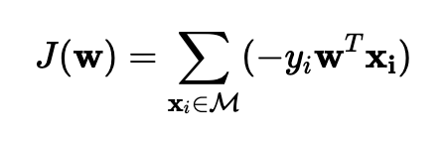
Learning Perceptron: loss function
Loss function counts the missed classified, in that case y_{i} and sgn(w^{T}x) are opposite signs, therefore: −y_{i}sgn(w^{T}xi)=1.
However, it is discrete then difficult to calculate derivative

Slide 19
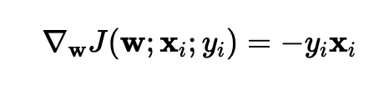
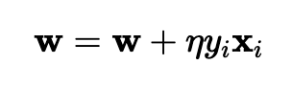
Learning Perceptron: update weight
Loss function
derivative
Update weight

Slide 20
References
https://www.xenonstack.com/blog/artificial-neural-network-applications/

